Slide 1

Transfer Learning
In practice, very few people train an entire Convolutional Network from scratch (i.e. random initialization of weights), because it is relatively rare to have a dataset of sufficient size.
Instead, it is common to pretrain a ConvNet on a very large dataset (e.g., ImageNet, which contains 1.2 million images with 1000 categories), and then use the ConvNet either as an initialization or a fixed feature extractor for the task of interest.
scenarios look as follows:

Slide 2
Transfer Learning Rationale
Training extensive models on vast image datasets like ImageNet can sometimes take weeks.
A model trained on so much data would have useful embeddings that can be applied to other image domains e.g. edge detectors, pattern and blob detectors
Example, an ImageNet model trained to detect Tigers, Lions and Horses might be useful to detect other 4-legged mammals
Transfer Learning is the concept where we utilise trained models in other domains to attain great accuracy as well as faster training times.

Slide 3
Transfer Learning - 2 Major Types
Feature Extractor
Fine Tuning

Slide 4
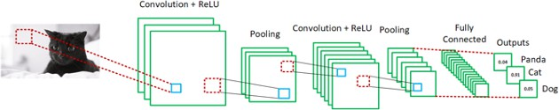
Transfer Learning - Feature Extractor
Take a pre-trained Network

Slide 5
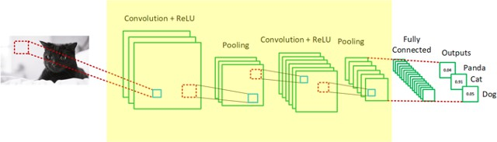
Transfer Learning - Feature Extractor
Freeze the CONV weights/layers - meaning they remain fixed

Slide 6
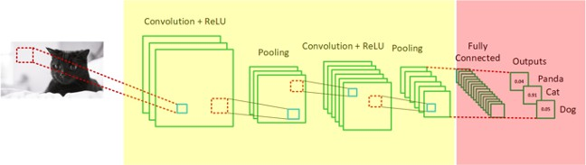
Transfer Learning - Feature Extractor
Replace the Top Layer with your Top Layer and train it

Slide 7
Transfer Learning - Feature Extractor
The steps involved in Transfer Learning by Feature Extraction
Freeze bottom layers of a pre-trained network
Replace the top half of the network with your top, so that it outputs only the number of classes in your dataset
Train the model on your new dataset
Pre-trained
Pre-trained
Trainable

Slide 8
Transfer Learning - Fine Tuning
In Fine Tuning, we complete all the steps in Feature Extraction but then we:
Unfreeze all or parts of the pre-trained model
Train the model for a few epochs, this is where we ‘fine tune’ the weights of the pre-trained model.
The intuition behind this is earlier features maps in a ConvNet learn generic features, while the later layers learn specifics about the image dataset. By fine tuning we change those specifics from the pre-trained model to the specifics of our dataset.
Pre-trained
Pre-trained
Make Trainable
Trainable
Trainable

Slide 9
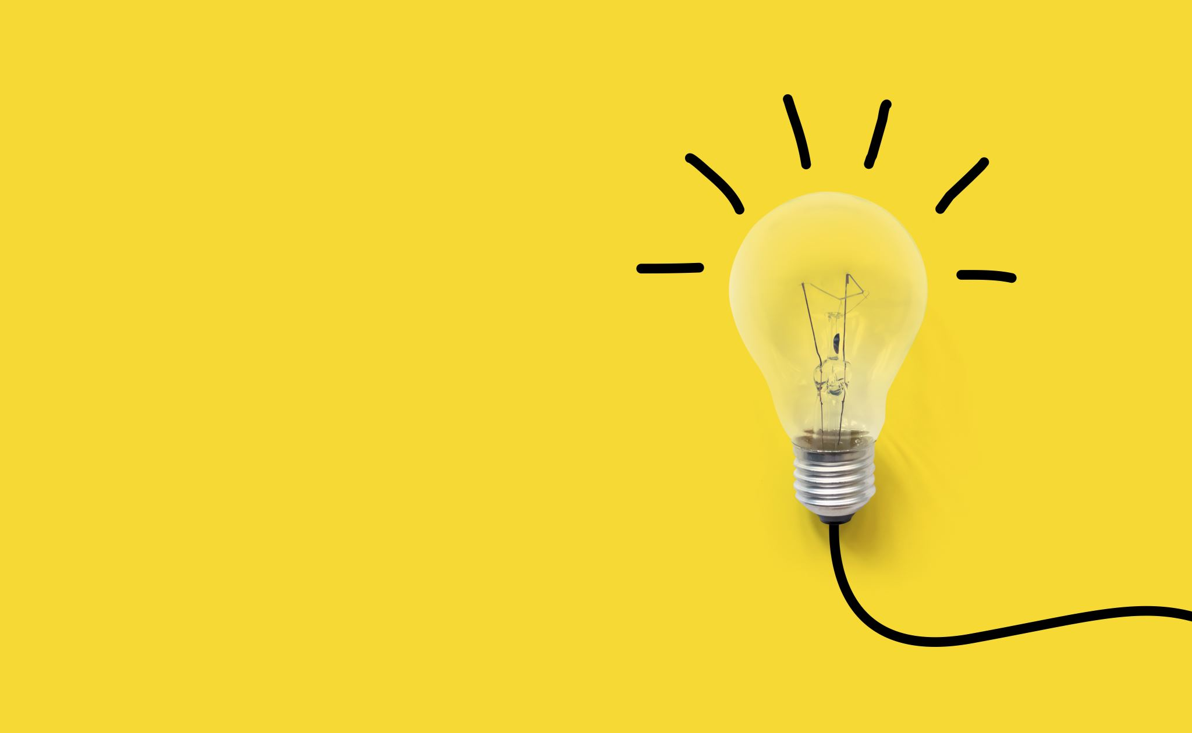
Transfer Learning - When Do We Use?
Ideal scenario - New dataset is large and similar to the pre-trained original dataset. Models should not overfit.
Not ideal but still recommended - New data is large but different.
If data is small (even if similar) Transfer Learning and Fine Tuning can often overfit on the training data. A useful idea at times is to train a linear classier on the CNN outputs.

Slide 10
Transfer Learning Advice
Learning Rates - use very small learning rates for pre-trained models especially when fine tuning. This is because we know the pertained weights are already very good and thus don’t want to change time too much
Due to parameter sharing you can train a pre-trained network on images of different sizes

